Slide 1
Active Damping of Missile Bending Vibrations
Anatole VERHAEGEN
Supervisor : Prof. Rafał Żbikowski
MBDA coordinator : Mr Graham Wallis

Slide 2
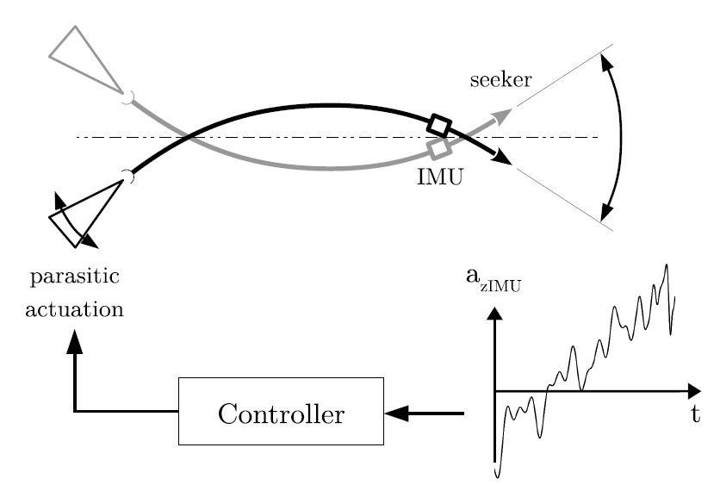
Why Active Damping ?

Slide 3
Servo-aeroelasticity Modeling
Control Architectures
Controllers Performance

Slide 4
Servo-aeroelasticity Modeling
ASTER-30 Characteristics
Flight Dynamics
Bending Dynamics
Aeroelasticity Interactions

Slide 5
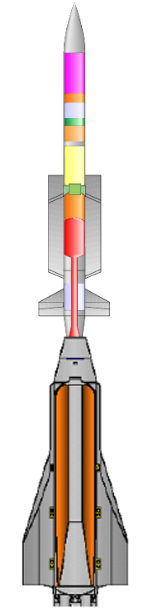
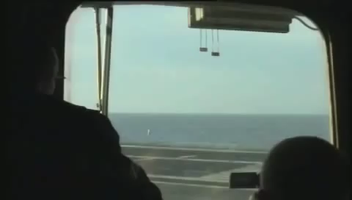
Aeroelasticity Modelling ASTER-30 Characteristics
Accelerometer
+
Gyroscope
Fins
Thrust Vectoring
Booster
Dart
2.2 m
310 kg
2.7 m
140 kg

Slide 6
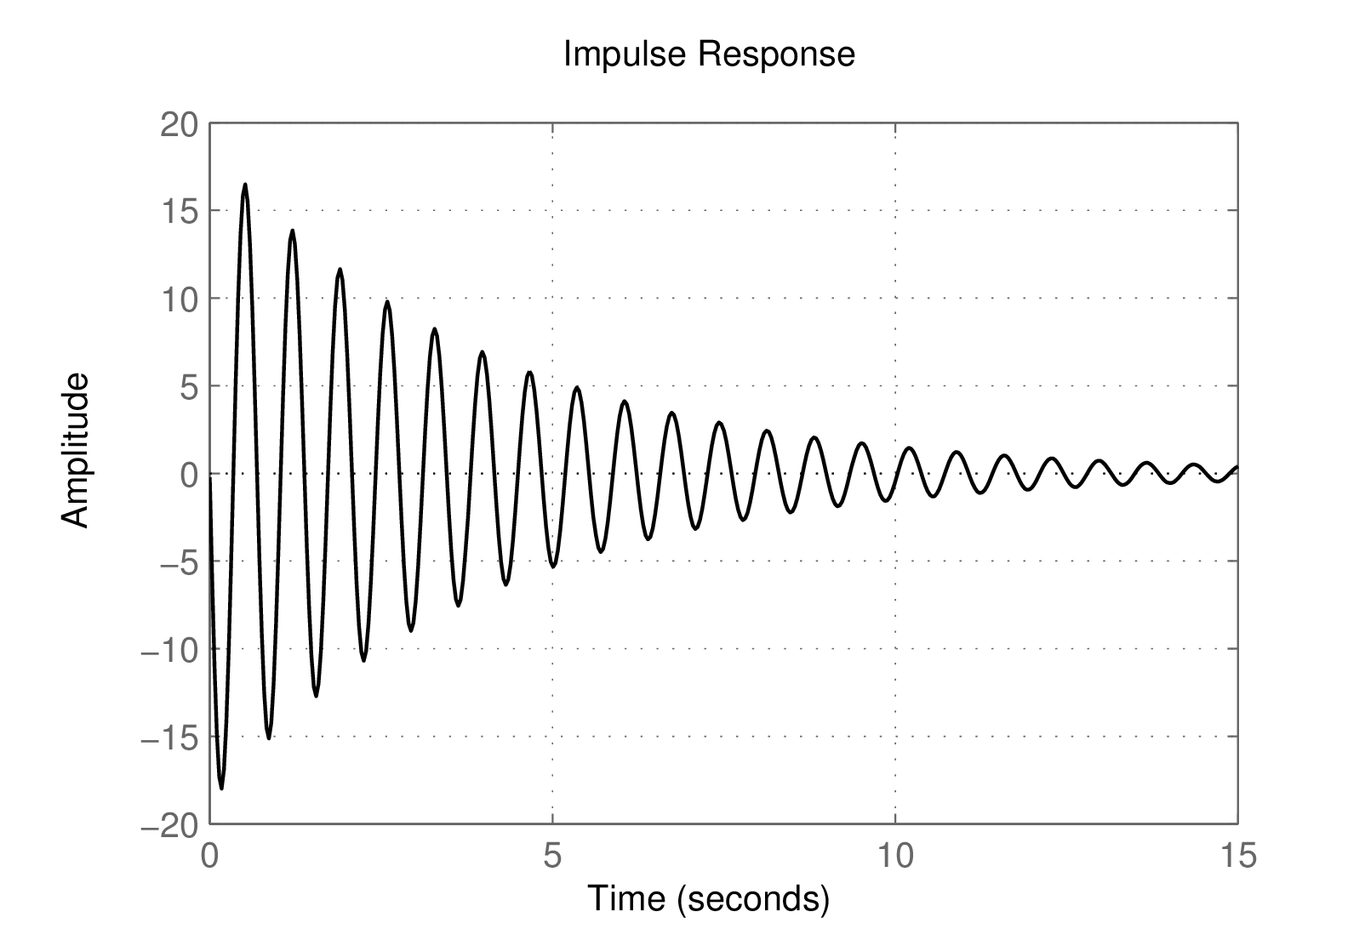
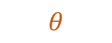
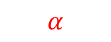
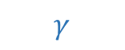
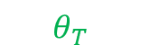

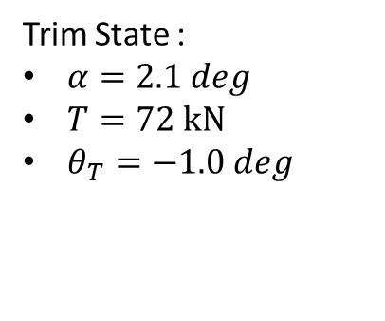
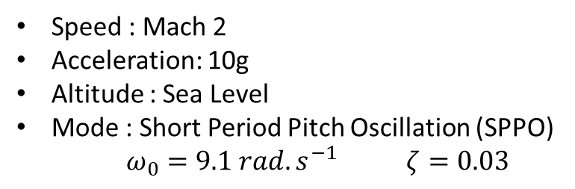
Aeroelasticity Modeling Flight Dynamics
Speed : Mach 2
Acceleration: 10g
Altitude : Sea Level
Mode : Short Period Pitch Oscillation (SPPO)
$ω_{0}=9.1 rad.s^{−1}$ $ζ=0.03$
Lift
Impulse Response – Thrust Inclinaison to Pitch Rate
Fins Lift
$$θ$$
$$α$$
0.7s
$$\vec{V}$$
$$γ$$
(rad/s)
Drag
Weight
Trim State :
$α=2.1 deg$
$T=72 kN$
$θ_{T}=−1.0 deg$
$$θ_{T}$$
Thrust

Slide 7
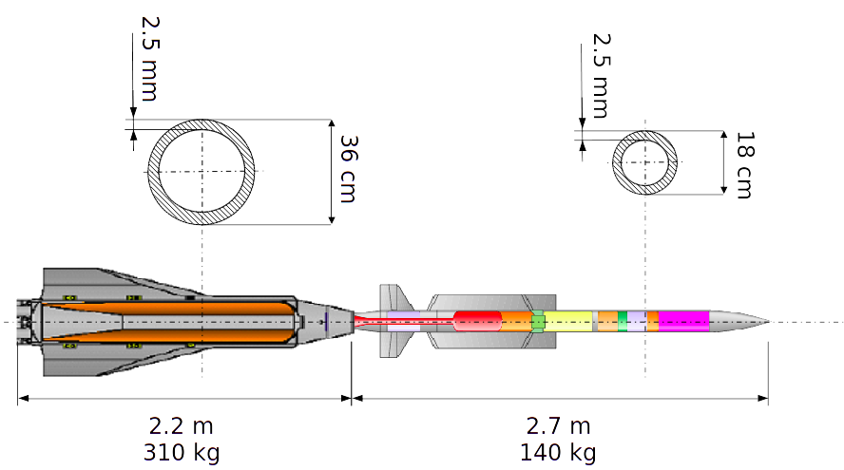
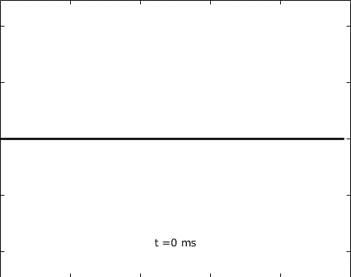

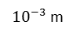
Aeroelasticity Modeling Bending Dynamics
Tail impact
Middle impact
${10}^{−3}$ m
${10}^{−3}$ m
m
2
2
1
1
0
0
Lateral deformation
-1
-1
-2
m
-2
m
0
1
2
3
4
5
0
1
2
3
4
5
${10}^{−3}$ m
${10}^{−3}$ m
2
2
1
1
Lateral deformation
0
0
Massless beam element
-1
-1
-2
m
-2
m
Point mass
0
1
2
3
4
5
0
1
2
3
4
5
Abscissa
Abscissa

Slide 8
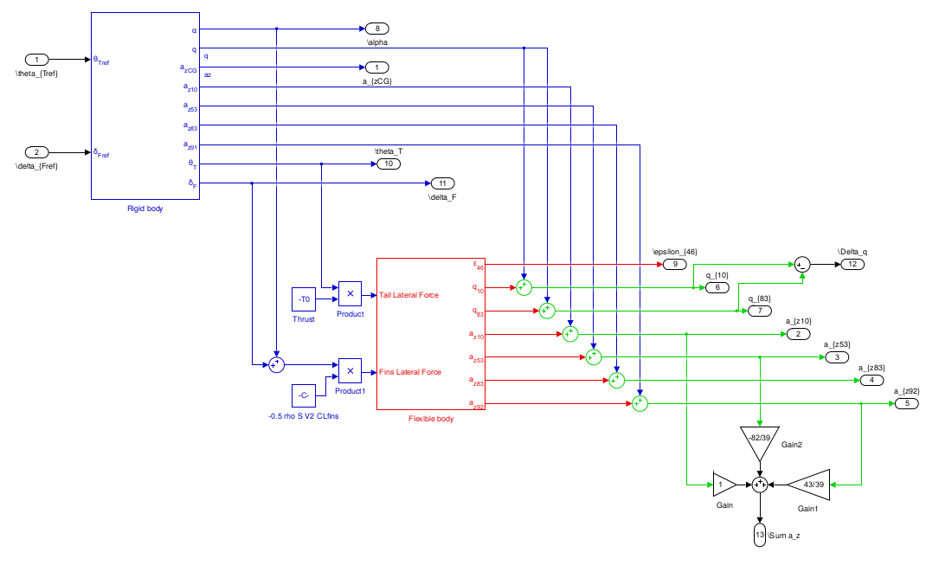
Aeroelasticity Modeling Aeroelasticity Interactions
Legend :
Flight Dynamics and Actuators
Structural Model
Servo-aeroelasticity

Slide 9
Control Architectures
Lateral Acceleration Control
Notch Filtering
Sensors Placement
Bending Active Damping

Slide 10
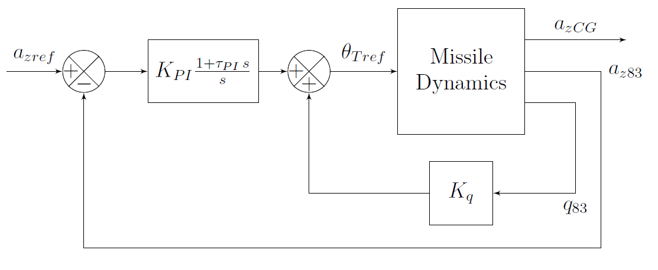
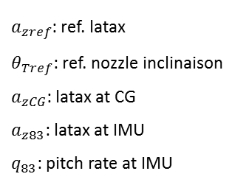
Control Architectures Lateral Acceleration Control
PI Controller
Latax Control
$a_{zref}$: ref. latax
$θ_{Tref}$: ref. nozzle inclinaison
$a_{zCG}$: latax at CG
$a_{z83}$: latax at IMU
$q_{83}$: pitch rate at IMU
Pitch Rate Feedback
SPPO Damping

Slide 11
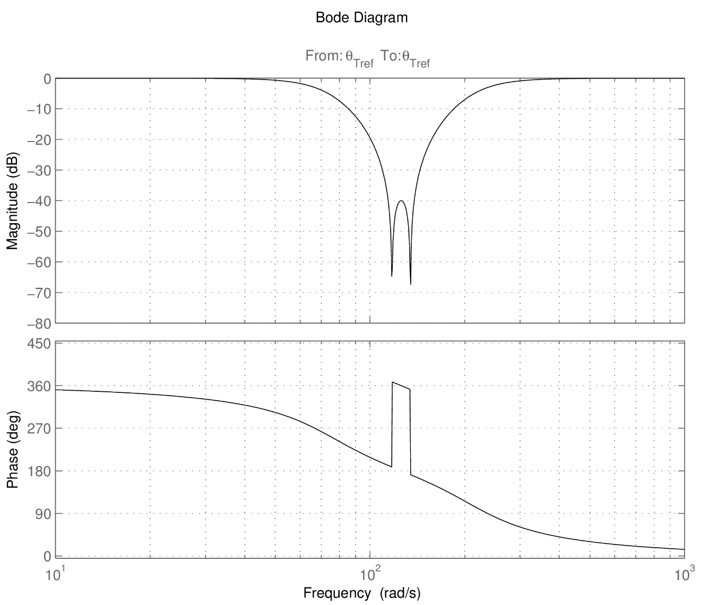
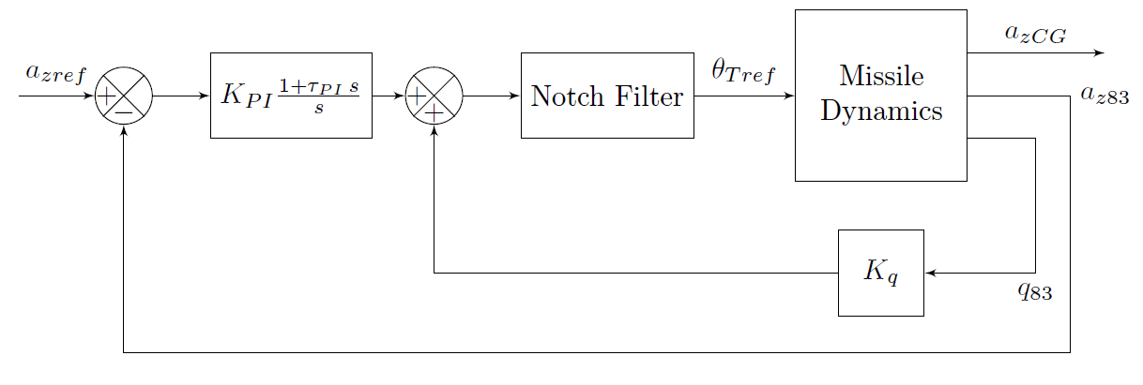
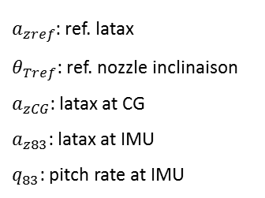
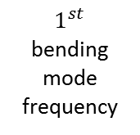
Control Architectures Notch Filtering
$1^{st}$ bending mode frequency
$a_{zref}$: ref. latax
$θ_{Tref}$: ref. nozzle inclinaison
$a_{zCG}$: latax at CG
$a_{z83}$: latax at IMU
$q_{83}$: pitch rate at IMU

Slide 12
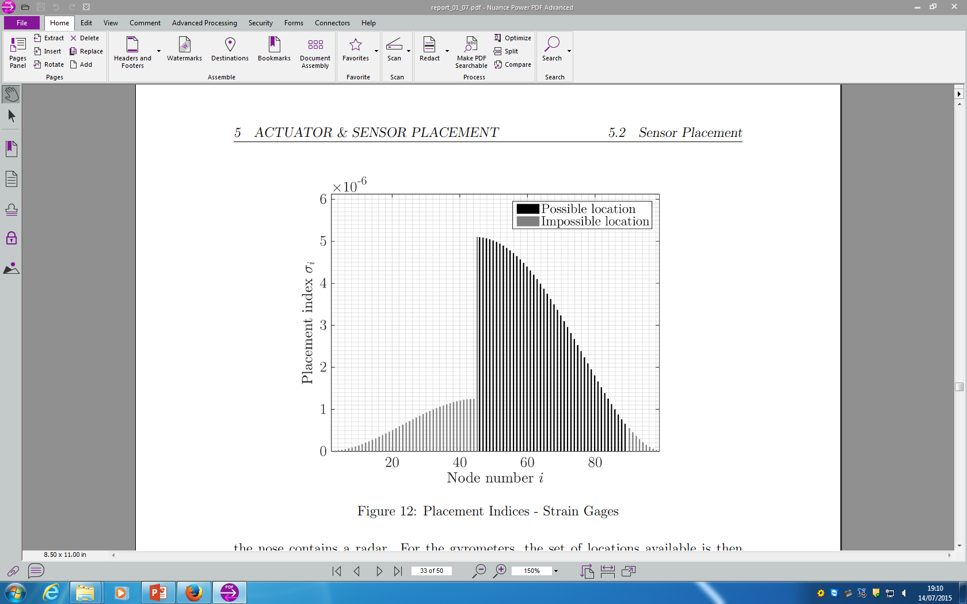
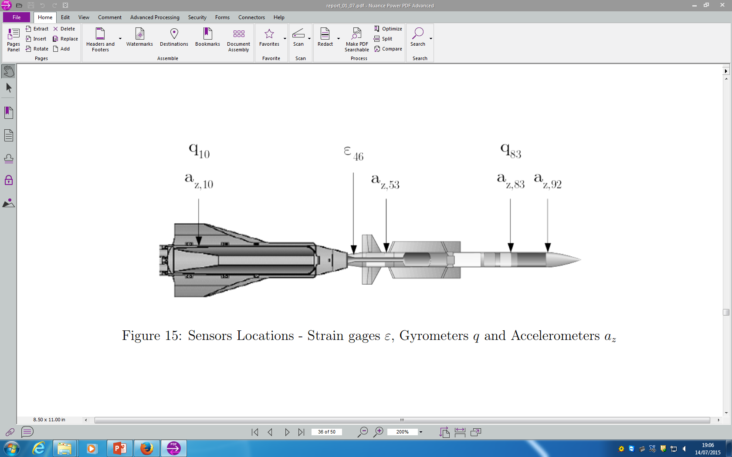
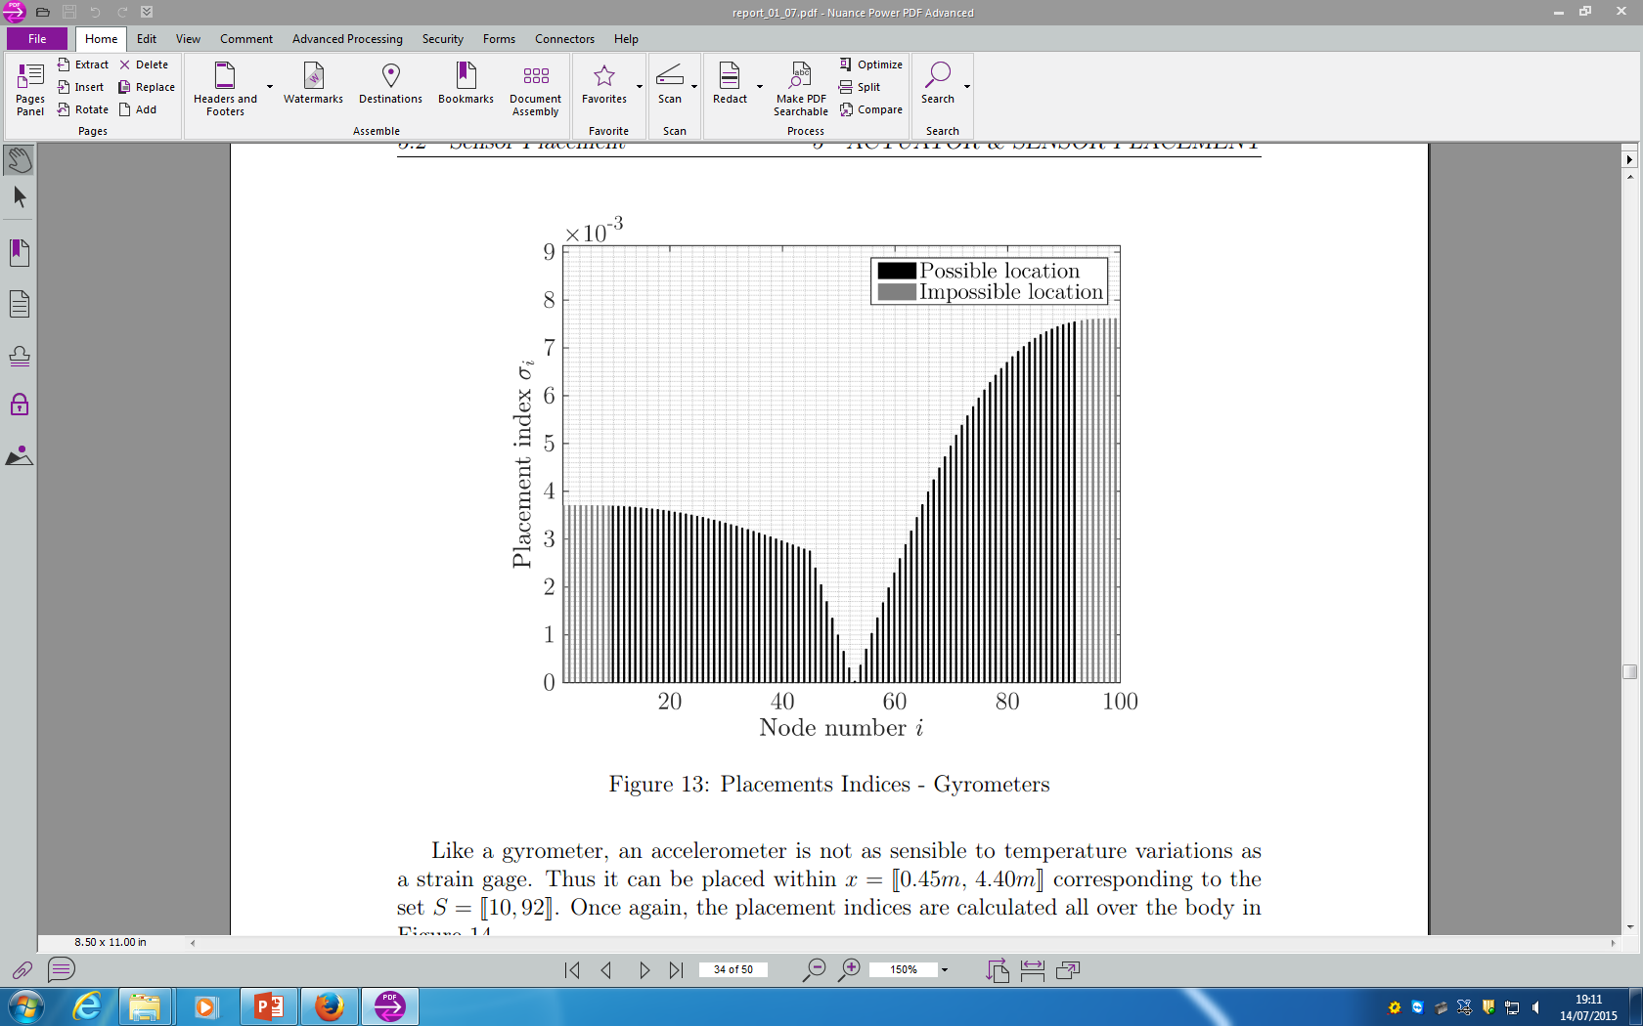
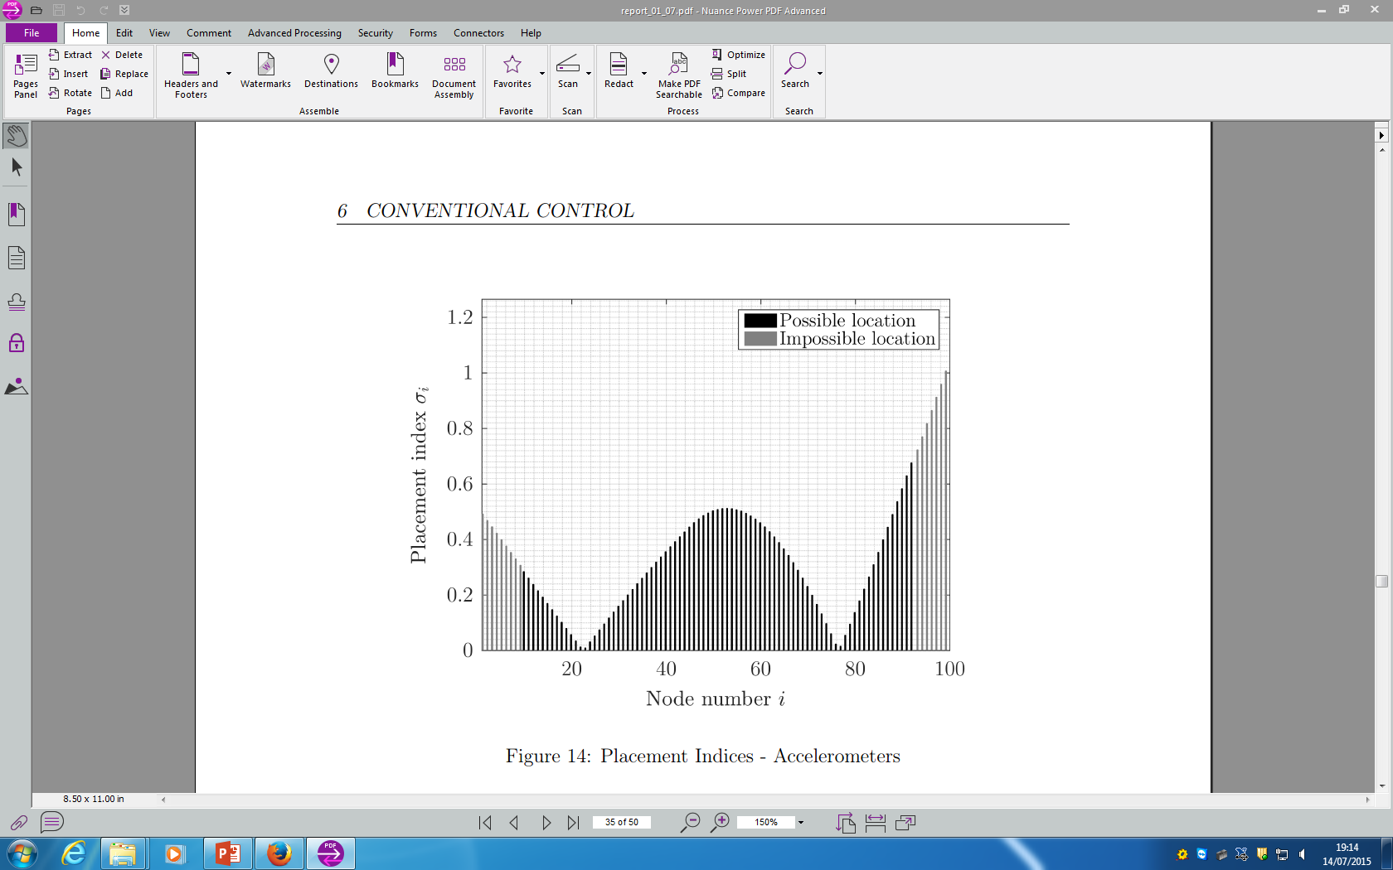
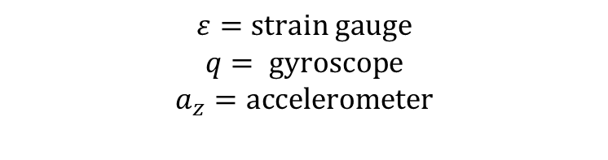
Control Architectures Sensors Placement
Strain Gauges
Sensors Locations
Gyroscopes
$$ε=strain gauge$$
$$q= gyroscope$$
$$a_{z}=accelerometer$$
Accelerometers

Slide 13
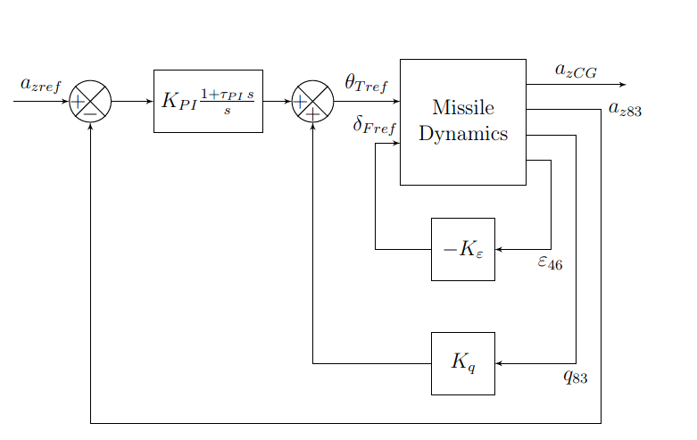
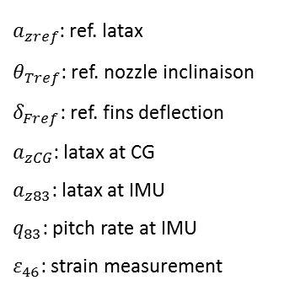
Control Architectures Bending Active Damping
Strain Feedback
Active Damping Using :
Strain gage measurement
Fins deflection
$a_{zref}$: ref. latax
$θ_{Tref}$: ref. nozzle inclinaison
$δ_{Fref}$: ref. fins deflection
$a_{zCG}$: latax at CG
$a_{z83}$: latax at IMU
$q_{83}$: pitch rate at IMU
$ε_{46}$: strain measurement

Slide 14
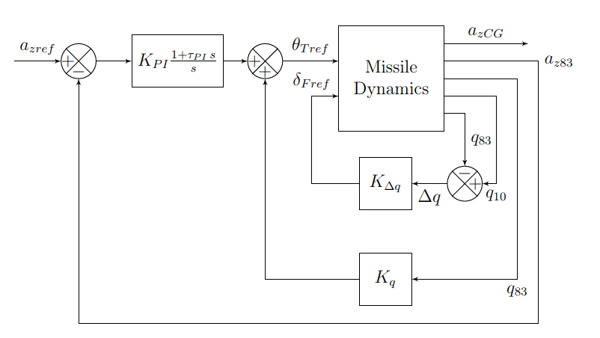
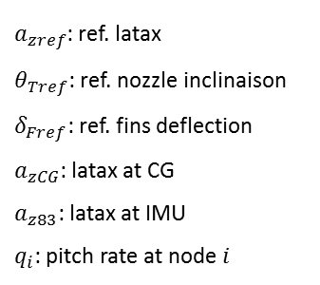
Control Architectures Bending Active Damping
Gyroscopes Feedback
Active Damping Using :
Front and rear gyroscopes
Fins deflection
$a_{zref}$: ref. latax
$θ_{Tref}$: ref. nozzle inclinaison
$δ_{Fref}$: ref. fins deflection
$a_{zCG}$: latax at CG
$a_{z83}$: latax at IMU
$q_{i}$: pitch rate at node $i$

Slide 15
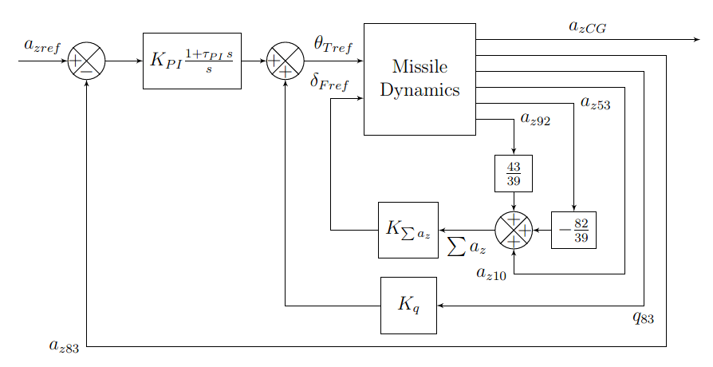
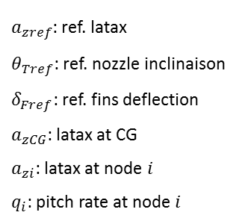
Control Architectures Bending Active Damping
Accelerometers Feedback
Active Damping Using :
Front, middle and rear accelerometers
Fins deflection
$a_{zref}$: ref. latax
$θ_{Tref}$: ref. nozzle inclinaison
$δ_{Fref}$: ref. fins deflection
$a_{zCG}$: latax at CG
$a_{zi}$: latax at node $i$
$q_{i}$: pitch rate at node $i$

Slide 16
Controllers Performance
Robustness to Uncertainty
Tracking
Bending Reduction

Slide 17
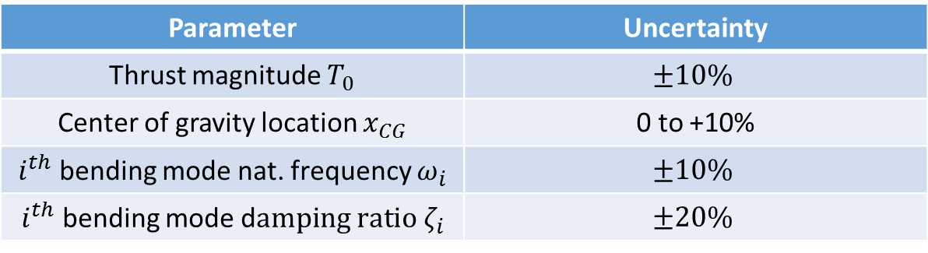
Control Architectures Robustness to Uncertainty
Parameter | Uncertainty
Thrust magnitude $T_{0}$ | $$±10\%$$
Center of gravity location $x_{CG}$ | 0 to +10%
$i^{th}$ bending mode nat. frequency $ω_{i}$ | $$±10\%$$
$i^{th}$ bending mode d$amping ratio ζ_{i}$ | $$±20\%$$

Slide 18
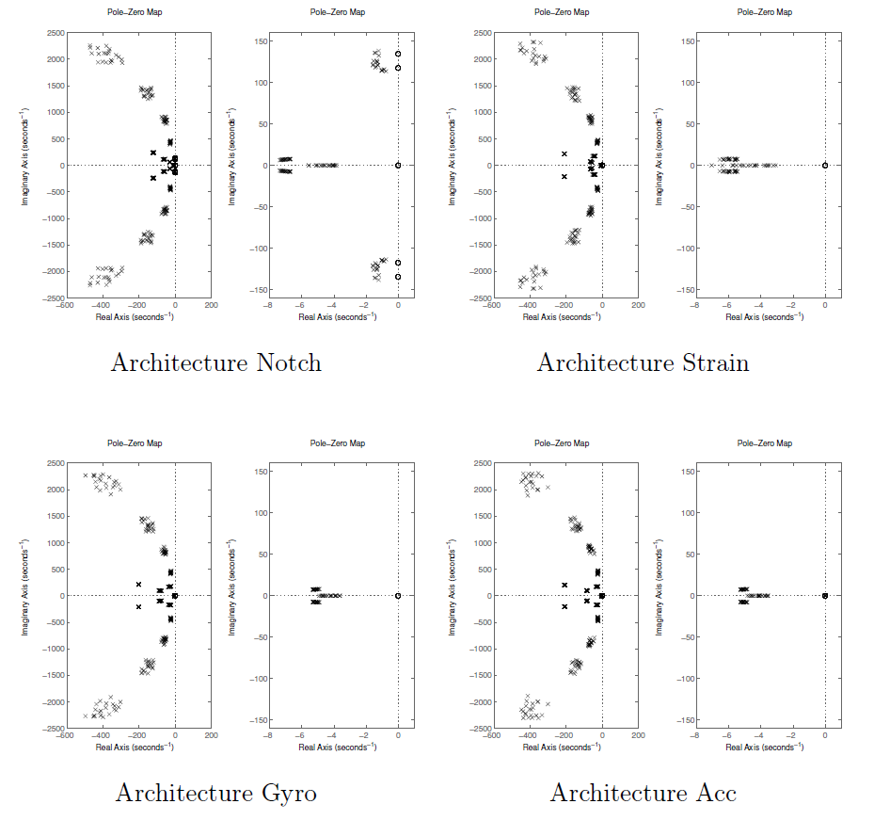
Control Architectures Robustness to Uncertainty
Poles (x) and Zeros (o) of the Uncertain Closed-Loop Systems

Slide 19
Control Architectures Robustness to Uncertainty
Poles (x) and Zeros (o) of the Uncertain Closed-Loop Systems

Slide 20
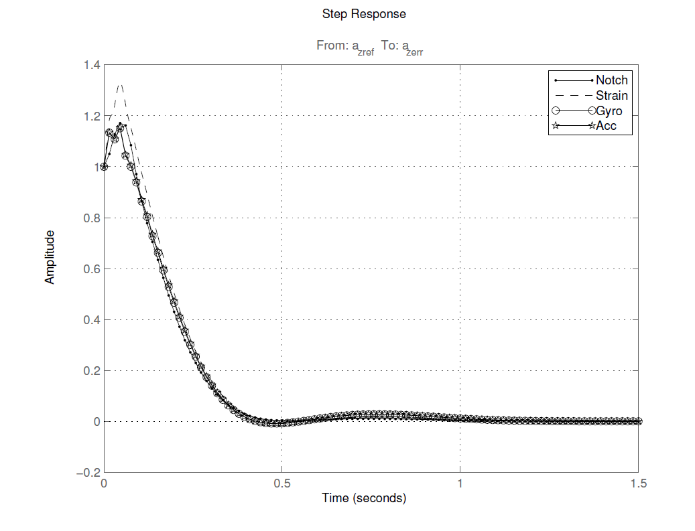
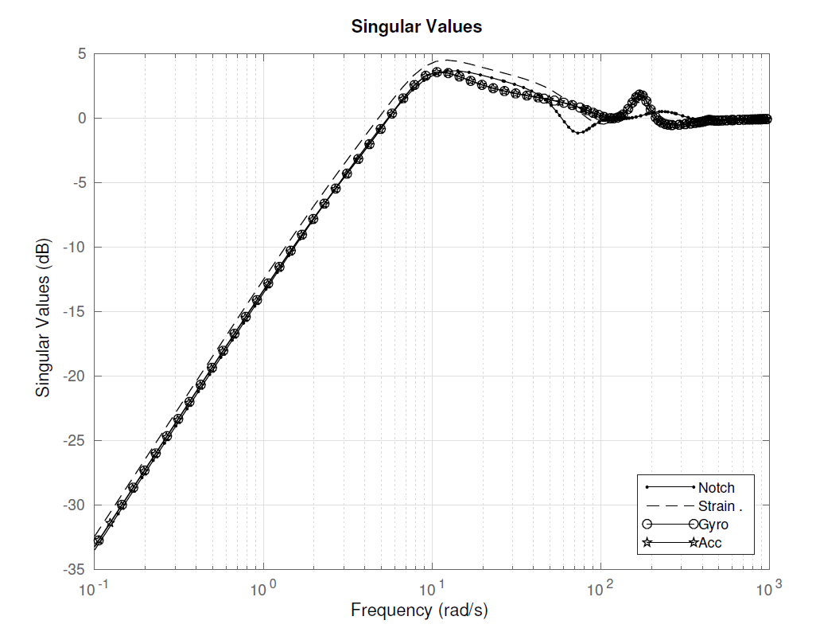
Control Architectures Tracking
Error Step Reponse
Error Magnitude

Slide 21
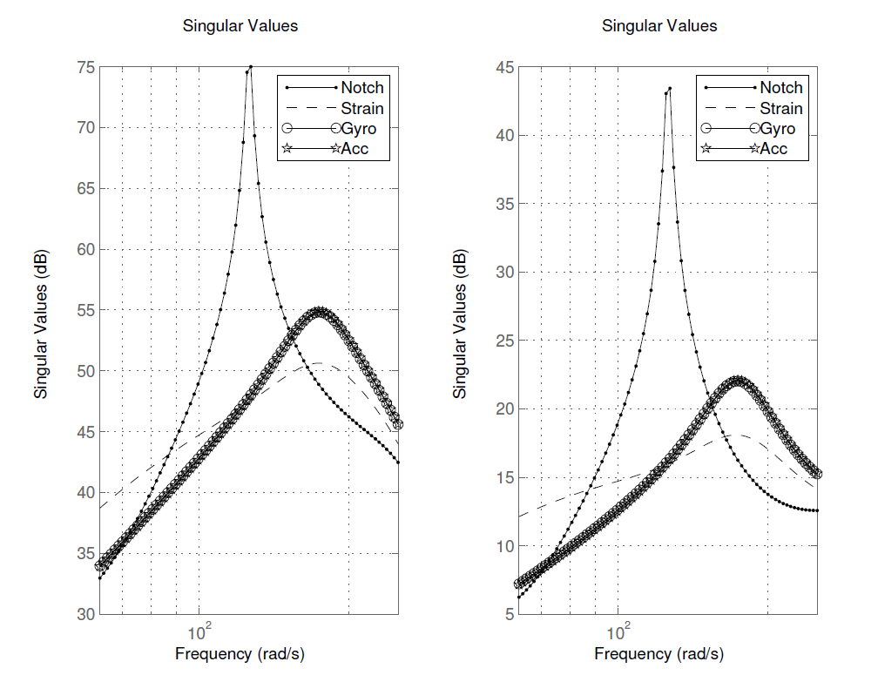
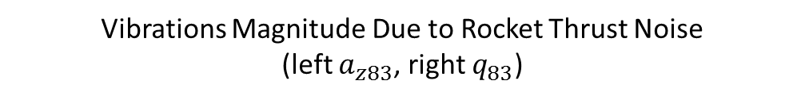
Control Architectures Vibrations Alleviation
Vibrations Magnitude Due to Rocket Thrust Noise
(left $a_{z83}$, right $q_{83}$)

Slide 22
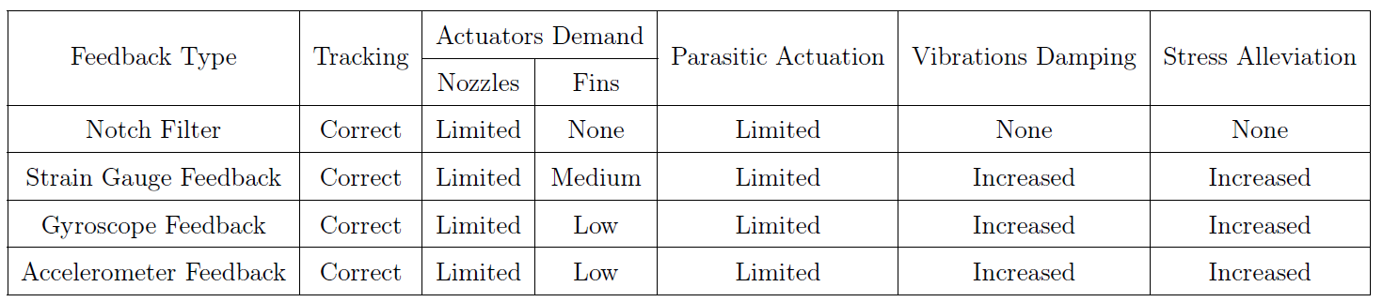
Summary and Conclusion
Table of Performance

Slide 23
Thank you

